Slide 1

Kaleem U Allah
05/16/2024

Slide 2

Outline
Executive Summary
Introduction
Methodology
Results
Conclusion
Appendix

Slide 3
Executive Summary
The process consisted of many critical components. First, we completely grasped the difficulty of forecasting the successful landing of the Falcon 9 first stage to estimate launch costs. We then compiled a thorough dataset utilizing SpaceX's API and web scraping tools. The obtained data proceeded through an understanding step (exploratory data analysis), in which visualization and descriptive statistics helped us comprehend the correlations between various aspects, and feature engineering assisted us in picking significant features for our research. Moving on to the preparation step, the data has been cleansed and preprocessed to ensure its quality and usefulness. We created and evaluated a variety of machine learning models, including logistic regression, decision trees, and support vector machines, with cross-validation approaches used to avoid overfitting. The models were tested using several measures.
The decision tree model emerged as the best performer, providing reliable predictions of landing success.

Slide 4
Introduction
In the competitive landscape of the aerospace industry, the ability to reduce launch costs is a significant advantage. SpaceX has revolutionized this domain by successfully reusing the first stage of its Falcon 9 rockets, bringing down the cost of launches to 62 million dollars compared to the industry standard of 165 million dollars. This cost-effectiveness is primarily due to the successful landing and reuse of the first stage, a critical component of their operational model.
The focus of this project is to predict the likelihood of a Falcon 9 first-stage landing successfully. Accurate predictions can provide essential insights into launch costs, aiding alternative companies in crafting competitive bids against SpaceX. By leveraging data science techniques, this project aims to understand the factors influencing landing success and develop predictive models to forecast this outcome reliably.

Slide 5

Section 1

Slide 6
Methodology
Executive Summary
Data collection methodology:
Data was collected using SpaceX API and web scraping techniques with Python’s beautiful soup, requests modules, and pandas library
Perform data wrangling
Data has been filtered out to only keep those related to Falcon 9. Then several information from different sources were aggregated to form a unique data frame where NaN values were dealt with. Feature engineering also helped drop irrelevant fields for further analysis
Perform exploratory data analysis (EDA) using visualization and SQL
Perform interactive visual analytics using Folium and Plotly Dash
Perform predictive analysis using classification models
We used the machine learning library scikit-learn to build several classification models. Those models have been evaluated to keep the best performing.

Slide 7
Data Collection
The data collection process primarily involved extracting comprehensive datasets related to all SpaceX launches from the SpaceX API. Using Python's requests library, we made requests to gather detailed information on launch dates, payload mass, launch sites, booster versions, landing outcomes... Further, we utilize a Wikipedia web page with web scraping techniques to extract more useful data on Falcon 9 launches. The collected data was then processed to ensure consistency and stored both in CSV files and SQLite 3 databases.

Slide 8
Data Collection – SpaceX API
Initial data collected fromhttps://api.spacexdata.com/v4/rockets/
Data has been parsed into DataFrame with pandas (Data content type: Json)
Based on the IDs obtained from the first API call, call: https://api.spacexdata.com/v4/launchpads/to obtain launchpads names and coordinates
https://api.spacexdata.com/v4/payloads/to obtain information about the payload (orbit, mass)
https://api.spacexdata.com/v4/cores/to obtain some useful information about the launch including its outcome
https://github.com/KaleemuAllah/IBM-Applied-DS-Capstone/blob/main/Week%201/spacex-data-collection-api.ipynb

Slide 9
Data Collection - Scraping
Get request tohttps://en.wikipedia.org/w/index.php?title=List_of_Falcon_9_and_Falcon_Heavy_launches&oldid=1027686922related to SpaceX's Falcon 9 launches
•Response's text content from the website parsed with BeautifulSoup
•All tables on the webpage has been extracted with query on the parsed html Response
•The table of interest has been selected
•A DataFrame has been created based on the table content
https://github.com/KaleemuAllah/IBM-Applied-DS-Capstone/blob/main/Week%201/webscraping.ipynb

Slide 10
Data Wrangling
After being collected, a DataFrame has been built upon the collected Data
Only relevant columns for our analysis have been kept
All rows on non-Falcon 9 launches have been filtered out
Missing values have been replaced by the mean of their columns
Categorical fields are encoded using One-hot encoding
An extra column called ‘Class’ is added. It equals 0 if a given launch was a failure and 1 if it was successful.
The final dataframe was cast float type
https://github.com/KaleemuAllah/IBM-Applied-DS-Capstone/blob/main/Week%201/spacex-Data%20wrangling.ipynb

Slide 11
EDA with Data Visualization
Several plots were made to get how each variables are related to each other and to the target variable :
Scatter plot: it helped us visualize the correlation between different variables and the target variable (the launch outcome); say otherwise, it helped identify how different features influence or impact the target variable and how they are correlated to each other.
Bar chart: helped us gain quantitative information on categorical variables; for instance, It helped us visualize the success rate of each orbit
Line plot: it helped us to visualize how a specific variable fluctuates or trends over time; we used it for instance to visualize how the success rate trends over years
https://github.com/KaleemuAllah/IBM-Applied-DS-Capstone/blob/main/Week%202/eda-dataviz.ipynb

Slide 12
EDA with SQL
SQL queries are used to perform the following EDA tasks :
Display the names of unique launch sites in the space missions
Display launch site records where the names begin with CCA
Display the total payload mass carried by boosters launched by NASA (CRS) : 45 596 Kg
Display average payload mass carried by booster version F9 v1.1: 2 928.4 Kg
Get the date of the first successful landing in the ground pad: 2015-12-22
List the names of the boosters which have success in drone ships and have payload mass greater than 4000 but less than 6000
List the total number of successful and failed mission outcomes
List the total number of successful and failed mission outcomes
Rank the count of landing outcomes (such as Failure (drone ship) or Success (ground pad)) between the date 2010-06-04 and 2017-03-20
https://github.com/KaleemuAllah/IBM-Applied-DS-Capstone/blob/main/Week%202/eda-sql-coursera_sqllite.ipynb

Slide 13
Build an Interactive Map with Folium
With Folium, different map objects object have been created :
Circle: to highlight a specific area
Markers: to mark a specific site and display its name when printed on it
Markers Cluster: to group several related markers with the ability to quickly identify which sites have the highest rate of success outcomes
Mouse Position: to quickly get coordinates of a place of interest; for instance, it helped us get the coordinates of some coastline points, highways, railways...
Poly Line: to visualize the distance between a site and a coastline point or some place of interest to state how close the launch site is to those places.
https://github.com/KaleemuAllah/IBM-Applied-DS-Capstone/blob/main/Week%203/launch_site_location.ipynb

Slide 14
Build a Dashboard with Plotly Dash
The following elements have been added to the dashboard :
A pie chart to visualize the success and the failure rate of a selected site and all sites
A dropdown input component to make the site selection
A scatter point chart to visualize the correlation between the payload mass and the success for all sites and a specific site
A range slider to select a payload range
https://github.com/KaleemuAllah/IBM-Applied-DS-Capstone/blob/main/Week%203/spacex_dash_app.py

Slide 15
Predictive Analysis (Classification)
Given the classification problem, we have built and evaluated several classification models following the steps :
We first standardize the dataset using a standard scaler
Split the dataset into train and test sets to prevent overfitting
Select a given model and a set of hyperparameters
Build a model using gridsearchcv and cross-validation to select the best parameters
Train the model on the train test
Evaluate the model on the test set
https://github.com/KaleemuAllah/IBM-Applied-DS-Capstone/blob/main/Week%204/SpaceX_Machine_Learning_Prediction_Part_5.jupyterlite.ipynb

Slide 16
Results
The results section will fall into three sub-sections :
Exploratory data analysis insights with SQL and static visualizations
Interactive analytics
Predictive analysis results

Slide 17

Section 2

Slide 18
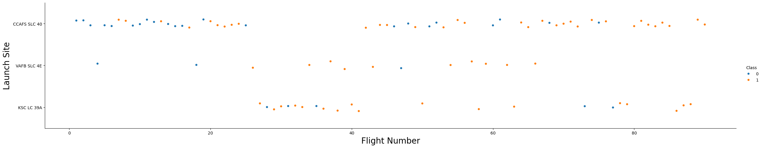
Flight Number vs. Launch Site
We see that as the flight number increases, the first stage is more likely to land successfully. The launch site is also important; it seems the more massive, the less likely the first stage will return.

Slide 19
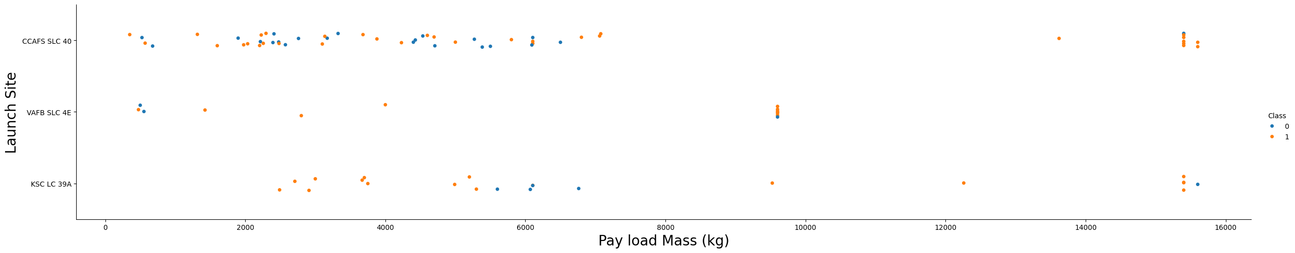
Payload vs. Launch Site

Slide 20
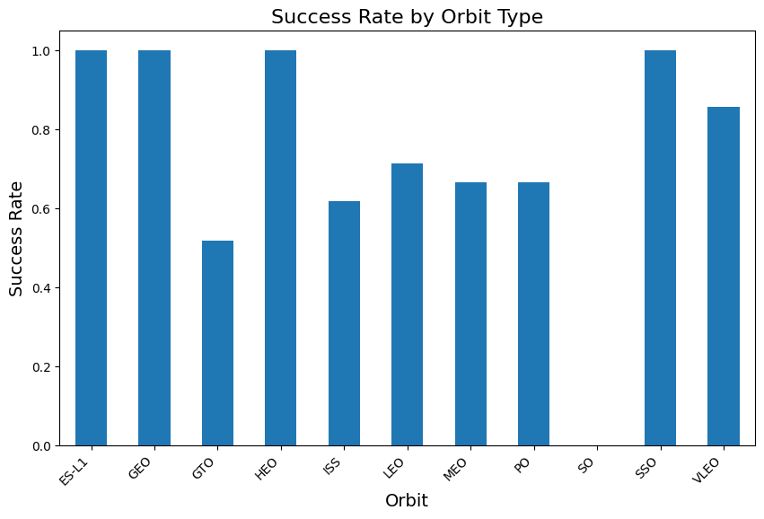
Success Rate vs. Orbit Type

Slide 21
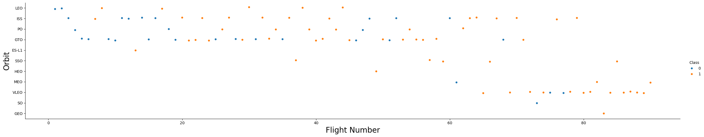
Flight Number vs. Orbit Type

Slide 22
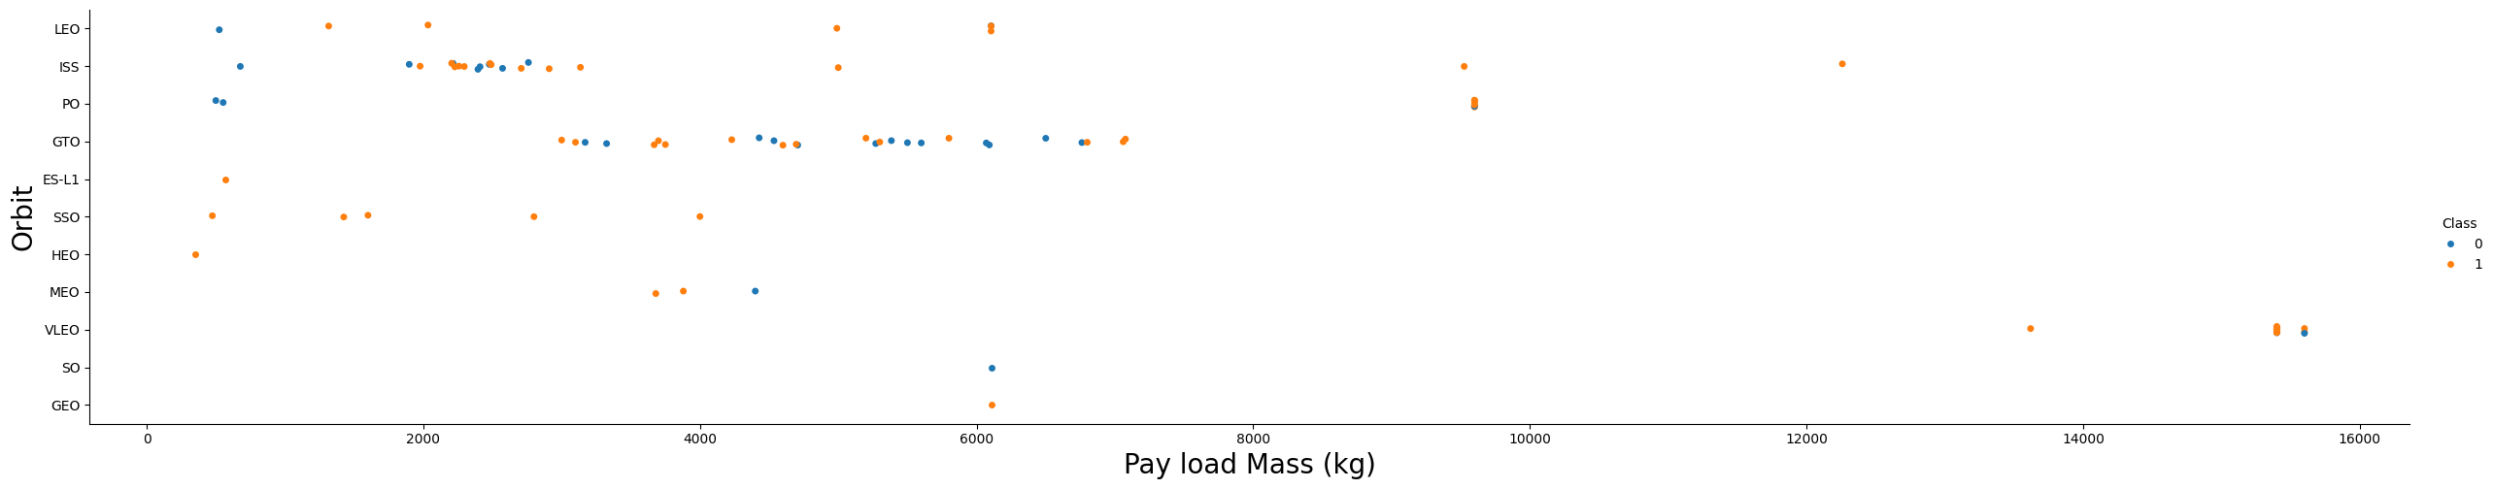
Payload vs. Orbit Type

Slide 23
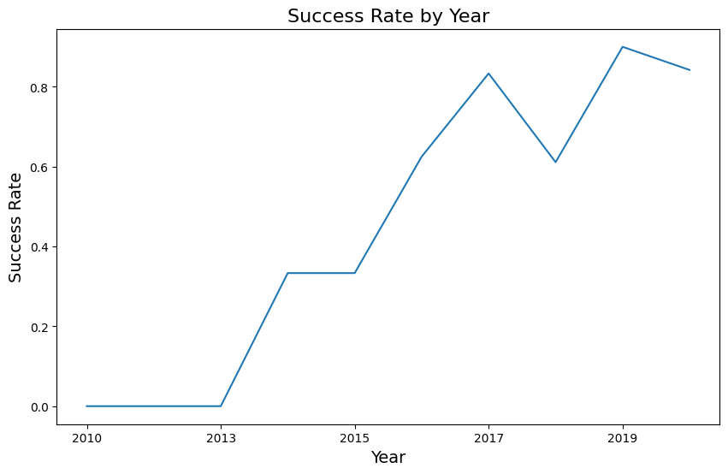
Launch Success Yearly Trend

Slide 24
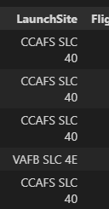
All Launch Site Names

Slide 25
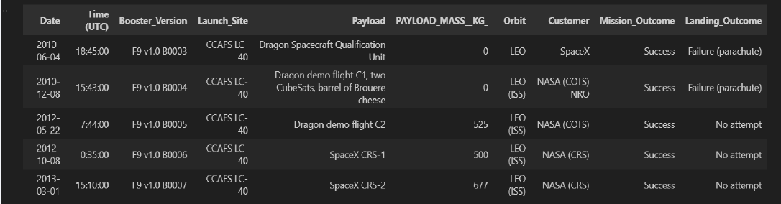
Launch Site Names Begin with 'CCA'

Slide 26
Total Payload Mass

Slide 27
Average Payload Mass by F9 v1.1

Slide 28
First Successful Ground Landing Date

Slide 29
Successful Drone Ship Landing with Payload between 4000 and 6000

Slide 30
Total Number of Successful and Failure Mission Outcomes

Slide 31
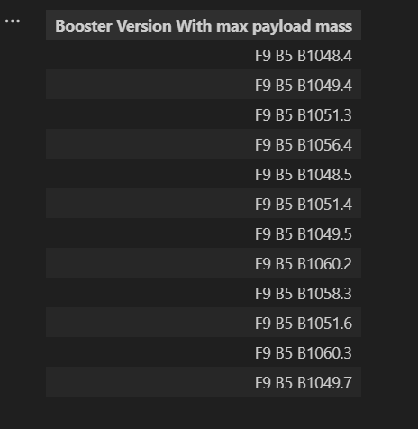
Boosters Carried Maximum Payload

Slide 32
2015 Launch Records

Slide 33
Rank Landing Outcomes Between 2010-06-04 and 2017-03-20

Slide 34

Section 3

Slide 35
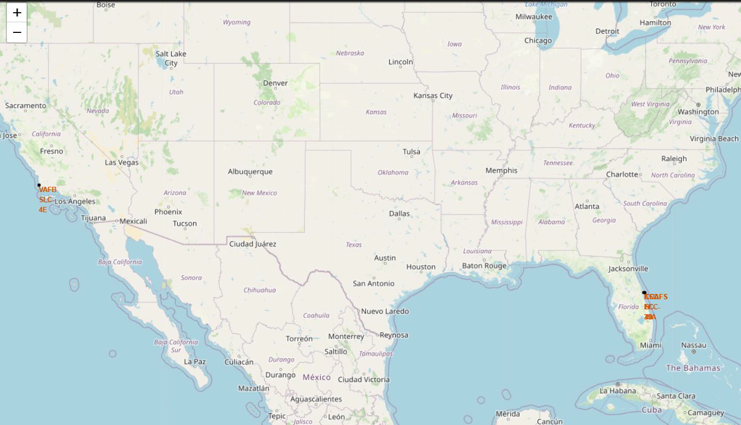
<Folium Map Screenshot 1>

Slide 36
<Folium Map Screenshot 2>
Replace <Folium map screenshot 2> title with an appropriate title
Explore the folium map and make a proper screenshot to show the color-labeled launch outcomes on the map
Explain the important elements and findings on the screenshot

Slide 37
<Folium Map Screenshot 3>

Slide 38

Section 4

Slide 39
<Dashboard Screenshot 1>
Replace <Dashboard screenshot 1> title with an appropriate title
Show the screenshot of launch success count for all sites, in a piechart
Explain the important elements and findings on the screenshot

Slide 40
<Dashboard Screenshot 2>
Replace <Dashboard screenshot 2> title with an appropriate title
Show the screenshot of the piechart for the launch site with highest launch success ratio
Explain the important elements and findings on the screenshot

Slide 41
<Dashboard Screenshot 3>
Replace <Dashboard screenshot 3> title with an appropriate title
Show screenshots of Payload vs. Launch Outcome scatter plot for all sites, with different payload selected in the range slider
Explain the important elements and findings on the screenshot, such as which payload range or booster version have the largest success rate, etc.

Slide 42

Section 5

Slide 43
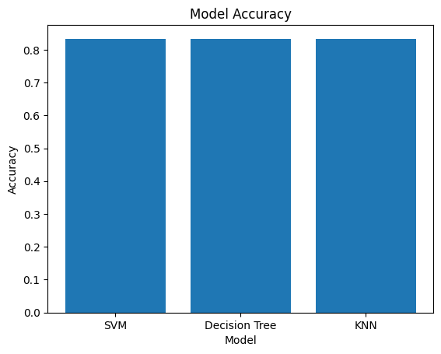
Classification Accuracy

Slide 44

Confusion Matrix

Slide 45
Conclusions
The objective of this project was to predict the successful landing of the Falcon 9 first stage, a critical factor in SpaceX's cost-effective launch operations.
•Each feature of the Falcon 9 launch, such as the payload mass, the launch site, or the orbit type, may affect the mission outcome.
•We collected comprehensive datasets exclusively from the SpaceX API and Wikipedia, which provided detailed information on launch parameters such as launch dates, payload mass, launch sites, booster versions, and landing outcomes...
•During the exploratory data analysis (EDA) phase, we examined the collected data to uncover patterns, trends, and relationships among the variables. We identified significant features influencing landing success, such as payload mass, and launch site ...
•We developed and tested several machine learning models to predict the successful landing of the Falcon 9 first stage. The models included logistic regression, support vector machine, decision tree, and K nearest neighbor. They all came out with the same score and the same confusion matrix during the evaluation phase. We finally keep the best model as the one with the highest accuracy during the cross-validation: the decision tree.

Slide 46
Appendix

Slide 47


